Slide 1


Optimization in Solar Power Generation
Presented by abel kurian

Slide 2
Contents
Business Objective
Business Constraints
Project Architecture - Data Flow Diagram
Data Collection
Exploratory Data Analysis
Data Visualization
Notes:
Change

Slide 3
Business Problem
Business problem: The company struggles with frequent fluctuations in energy output caused by variable environment conditions and system inefficiencies are limiting optimal solar power generation.
Business objective : Maximize Power Production and Performance.
Business Constraints : Minimize operational cost.
Business success criteria : achieve a 20-30% increase in profit.
Economic success criteria : Increase 30% in revenue, and reduce operational costs through improved solar power generation efficiency.

Slide 4
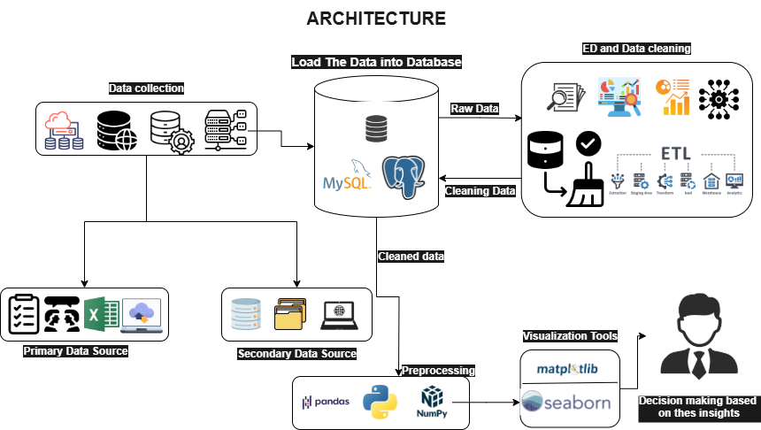
Project Overview and Scope

Slide 5
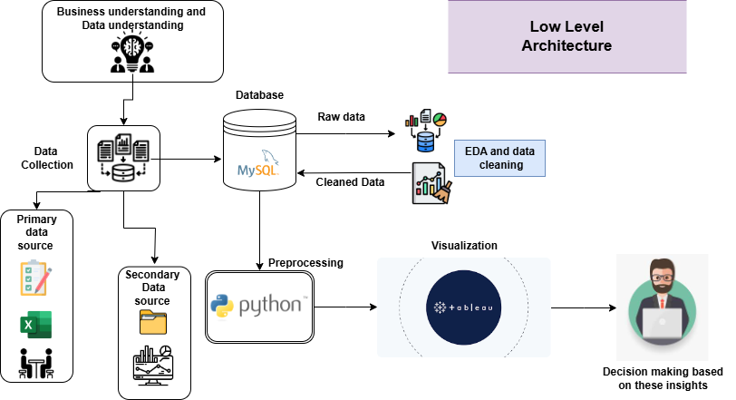
Project Overview and Scope

Slide 6
Data Dictionary
Inverter dataset
WMS Report
Data Dictionary
Column Name | Data Type | Description
DATE/TIME | Date Time | Timestamp of recorded data in "DD-MM-YYYY HH:MM" format.
Power of inverter 1 in unit 1 | Float | Power output of inverter 1 in unit 1 (measured in watts or kilowatts).
Power of inverter 2 in unit 1 | Float | Power output of inverter 2 in unit 1 (measured in watts or kilowatts).
Power of inverter 1 in unit 2 | Float | Power output of inverter 1 in unit 2 (measured in watts or kilowatts).
Power of inverter 2 in unit 2 | Float | Power output of inverter 2 in unit 2 (measured in watts or kilowatts).
Data Dictionary
Column Name | Data Type | Description
DATE & TIME | Date Time | Timestamp indicating the date and time of the recorded data.
GII | Integer | Global Irradiance Index (GII), possibly a measure of solar irradiance
MODULE TEMP.1 | Float | Temperature of the module possibly a solar panel.
RAIN | Float | Rainfall Measurement
AMBIENT TEMPRETURE | Float | This column represents the ambient temperature, likely in degrees Celsius
RAIN CATEGORY | Text | This column shows whether its a raining day or not

Slide 7
Exploratory Data Analysis [EDA]
Statistical Insights
Business Insights
Inverter Dataset
Power of inverter 1 in unit 1 : The data is right-skewed with a mean (699.15) significantly higher than the median (60.09). High variance (889804.89) and standard deviation (943.29) indicate strong fluctuations in power output, leading to unstable inverter performance. Skewness (1.029) confirms this right skew, while a platykurtic kurtosis (-0.511) suggests fewer extreme values in the distribution.
Power of inverter 2 in unit 1 : The data for Power of Inverter 2 in Unit 1 is right-skewed, with a mean (676.26) significantly higher than the median (24). High variance (846658.51) and standard deviation (920.14) indicate strong fluctuations in power output, leading to unstable inverter performance. Skewness (1.042) confirms the right-skewed nature, while a platykurtic kurtosis (-0.474) suggests fewer extreme values in the distribution.
Power of inverter 1 in unit 2 : The data for Power of Inverter 1 in Unit 2 is right-skewed, with a mean (684.74) significantly higher than the median (65.19). High variance (856766.88) and standard deviation (925.62) indicate strong fluctuations in power output, leading to unstable inverter performance. Skewness (1.051) confirms the right-skewed nature, while a platykurtic kurtosis (-0.437) suggests fewer extreme values in the distribution
Inverter Dataset
Power of inverter 1 in unit 1 : The high variance and standard deviation indicate strong fluctuations in power output, leading to unstable inverter performance. The right-skewed distribution suggests that most of the time, the power output is low, but there are occasional high-power events. This instability could lead to inefficiencies and potential maintenance issues.
Power of inverter 2 in unit 1 : Similar to Inverter 1 in Unit 1, the high variance and standard deviation indicate significant fluctuations in power output, suggesting unstable performance. The right-skewed distribution implies that the inverter often operates at lower power levels, with occasional spikes. This could result in inconsistent energy production and potential reliability concerns.
Power of inverter 1 in unit 2 : The high variance and standard deviation point to strong fluctuations in power output, indicating unstable inverter performance. The right-skewed distribution suggests that the inverter frequently operates at lower power levels, with occasional high-power events. This could lead to inefficiencies and potential maintenance challenges.
Notes:
EDA is used for seeing what the data can tell us before the modeling task.
Change

Slide 8
Exploratory Data Analysis [EDA]
Statistical Insights
Business Insights
Power of inverter 2 in unit 2 :The data for Power of Inverter 2 in Unit 2 is right-skewed, with a mean (710.87) significantly higher than the median (66.69). High variance (917245.55) and standard deviation (957.73) indicate strong fluctuations in power output, leading to unstable inverter performance. Skewness (1.035) confirms the right-skewed nature, while a platykurtic kurtosis (-0.489) suggests fewer extreme values in the distribution.
WMS Report
GII : The GII data shows a slight right skew (0.172), with the mean (437.59) being close to the median (399), indicating a nearly symmetrical distribution. Moderate variability is observed, with a variance of 94488.01 and a standard deviation of 307.39, suggesting fluctuations in solar radiation but not extreme instability. A platykurtic kurtosis (-1.396) indicates a flatter distribution with fewer extreme values.
MODULE TEMP.1 :The MODULE TEMP.1 data shows a slight left skew (-0.403), with the mean (42.10) and median (42.5) being nearly identical, indicating a symmetrical distribution. The low variance (148.44) and standard deviation (12.18) suggest that panel temperatures are relatively stable. The kurtosis (-0.133) is close to zero, implying a nearly normal distribution, meaning temperature values do not have extreme outliers.
Power of inverter 2 in unit 2 : The high variance and standard deviation indicate significant fluctuations in power output, leading to unstable inverter performance. The right-skewed distribution suggests that the inverter often operates at lower power levels, with occasional spikes. This could result in inconsistent energy production and potential reliability issues.
WMS Report
GII : The moderate variability in solar radiation suggests that while there are fluctuations, they are within a manageable range. The slight right skew indicates mostly stable solar irradiation with minor high outliers. This stability is beneficial for consistent energy production, but the minor variations should be monitored to optimize performance.
MODULE TEMP.1 : The low variance indicates that panel temperatures are relatively stable around 42°C, which is favorable for consistent energy production. The slight left skew suggests that lower temperatures are slightly more frequent, which is generally good for panel efficiency. The stable temperature readings indicate reliable performance under current conditions.
Notes:
EDA is used for seeing what the data can tell us before the modeling task.
Change

Slide 9
Exploratory Data Analysis [EDA]
Statistical Insights
Business Insights
RAIN :The RAIN data shows an extremely right-skewed distribution (110.1651) with a mean (0.00059) and mode at zero, indicating that rainfall is rare and infrequent. The variance (0.000657) and standard deviation (0.0279) are extremely low, further confirming minimal fluctuation in rainfall. The kurtosis (14598.5) is extremely high, indicating a heavy-tailed (leptokurtic) distribution, meaning that when rainfall does occur, it is likely to be an extreme event.
AMBIENT TEMPRETURE :The AMBIENT TEMPERATURE data indicates stable environmental conditions with a mean (34.43) and median (35.1) being very close, suggesting a symmetrical distribution. The variance (30.88) and standard deviation (5.56) are relatively low, reinforcing temperature stability. The skewness (-0.246) shows a slight left skew, meaning temperatures have somewhat lower extreme values. The kurtosis (-0.791) suggests a flatter than normal (platykurtic) distribution, meaning fewer extreme temperature fluctuations.
RAIN : The extremely low variance and high skewness indicate that rainfall is rare and infrequent, with most values being zero. However, the presence of extreme outliers suggests occasional heavy rainfall events. This rarity of rain is generally positive for solar energy production, but the extreme events could cause temporary disruptions.
AMBIENT TEMPRETURE : The stable ambient temperatures indicate predictable environmental conditions, which is beneficial for consistent energy production. The slight left skew suggests that temperatures tend to be slightly lower than the mean, which is generally favorable for panel efficiency. The flatter distribution indicates no extreme temperature fluctuations, contributing to reliable performance.
Notes:
EDA is used for seeing what the data can tell us before the modeling task.
Change

Slide 10
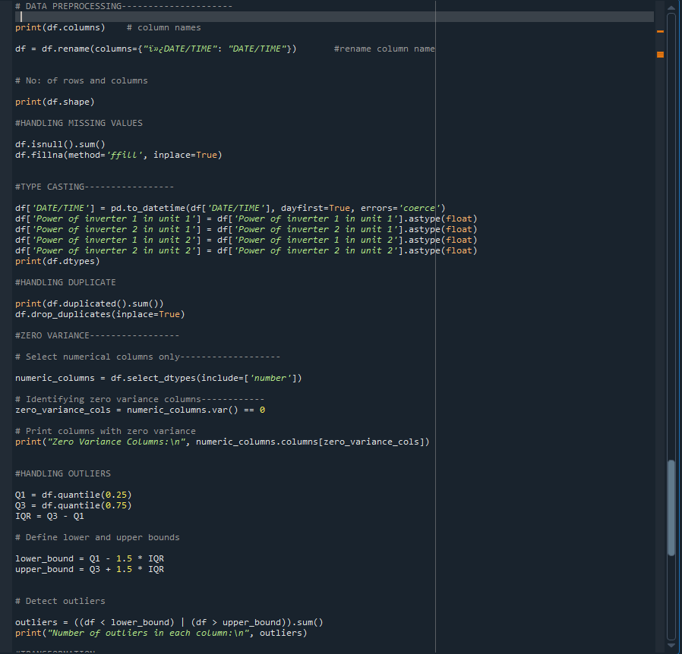
Data Preprocessing
Inverter dataset
Notes:
Keep observations

Slide 11
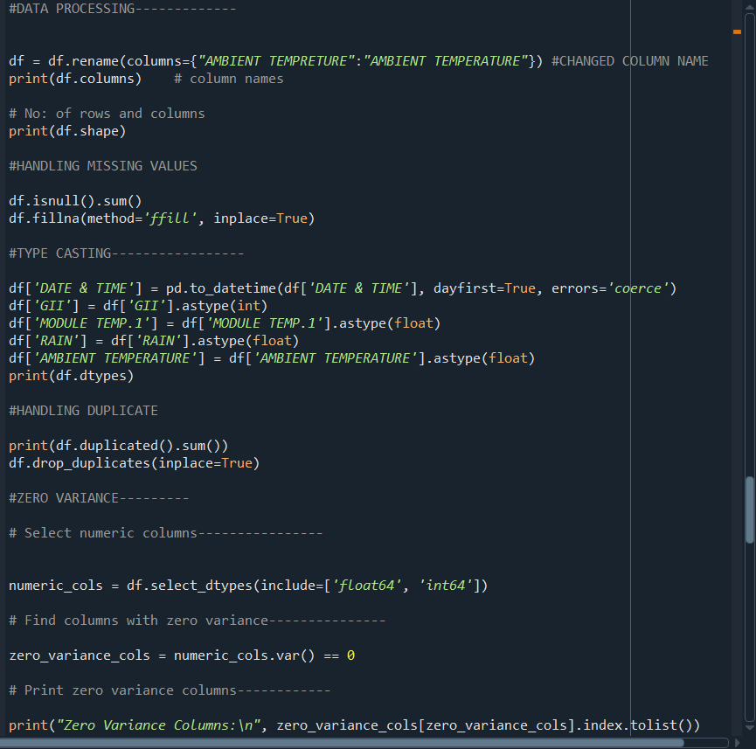
Data Preprocessing
WMS REPORT
Notes:
Keep observations

Slide 12
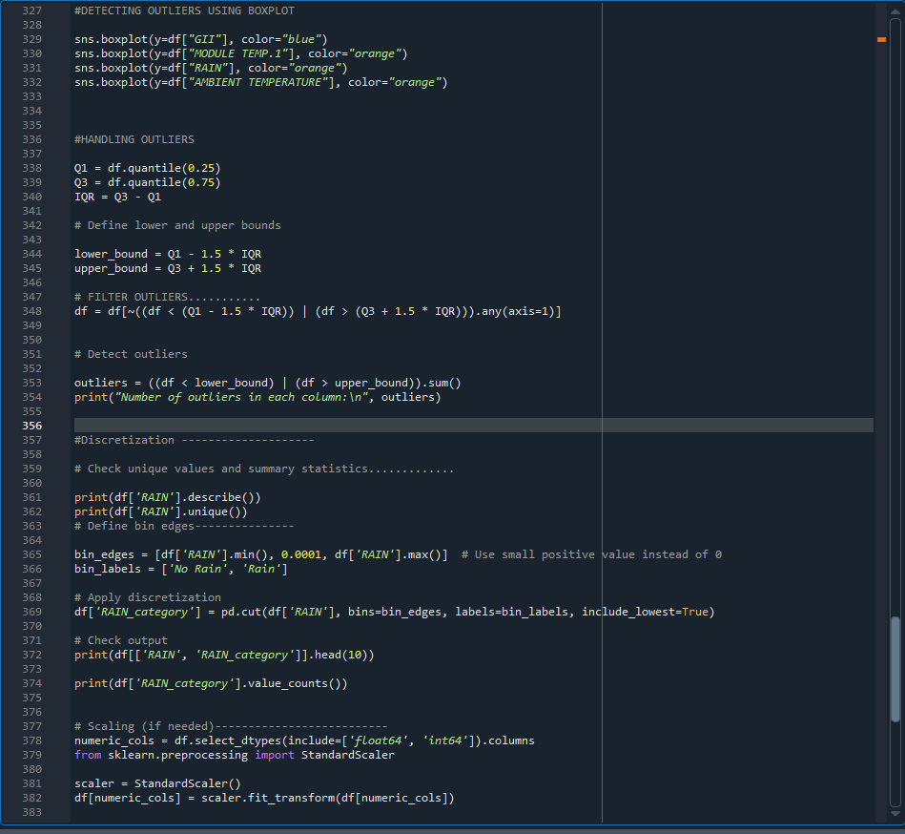
Data Preprocessing
WMS REPORT
Notes:
Keep observations

Slide 13
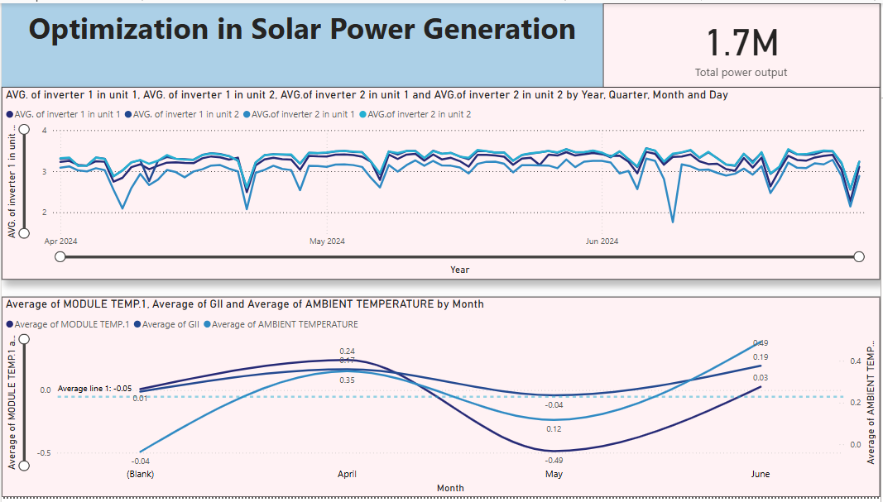
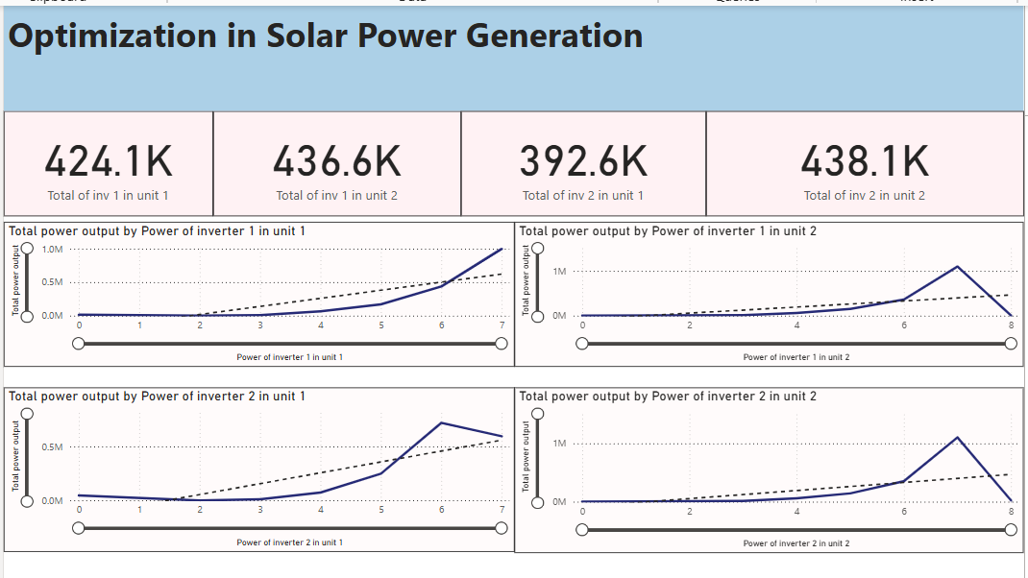
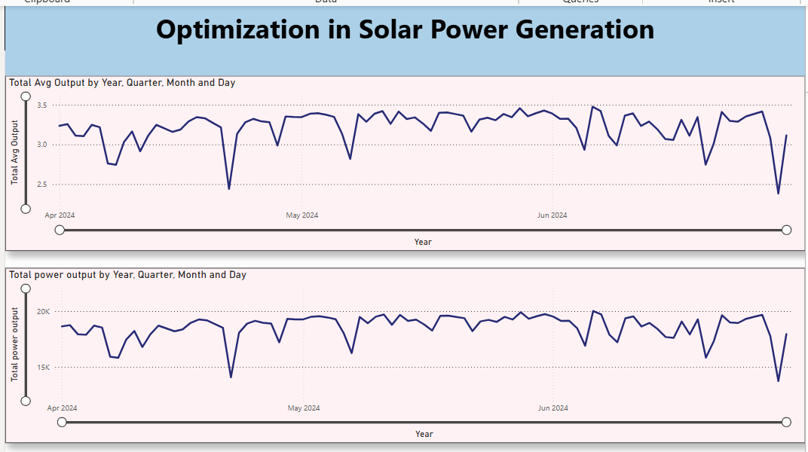
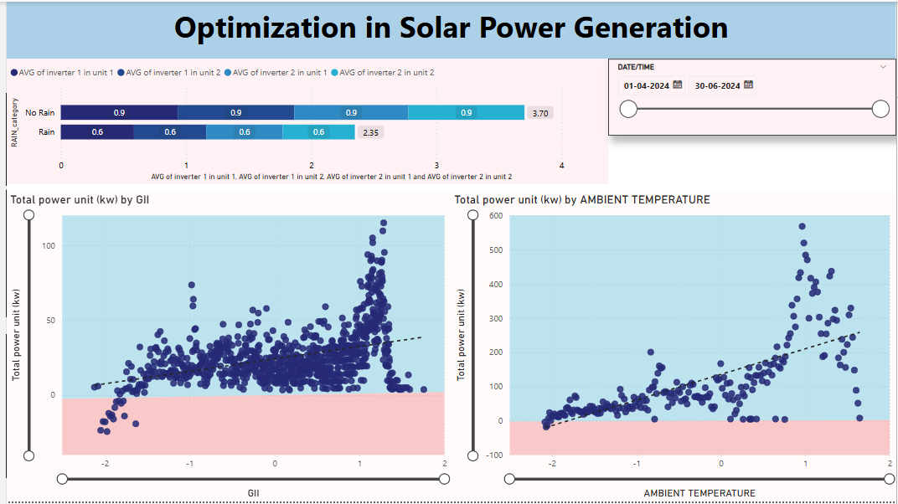
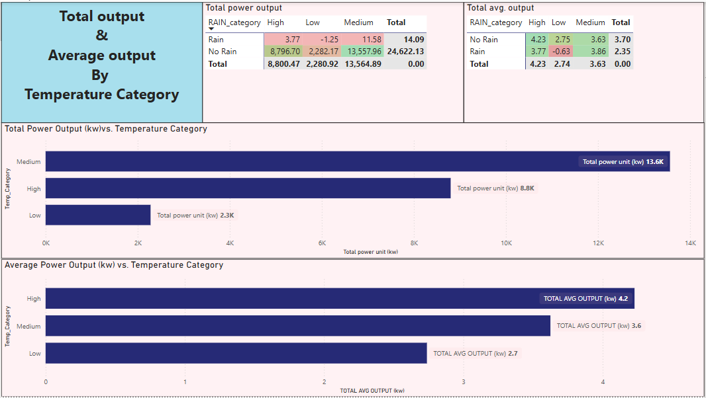
Data Visualization
Notes:
Add graphical

Slide 14
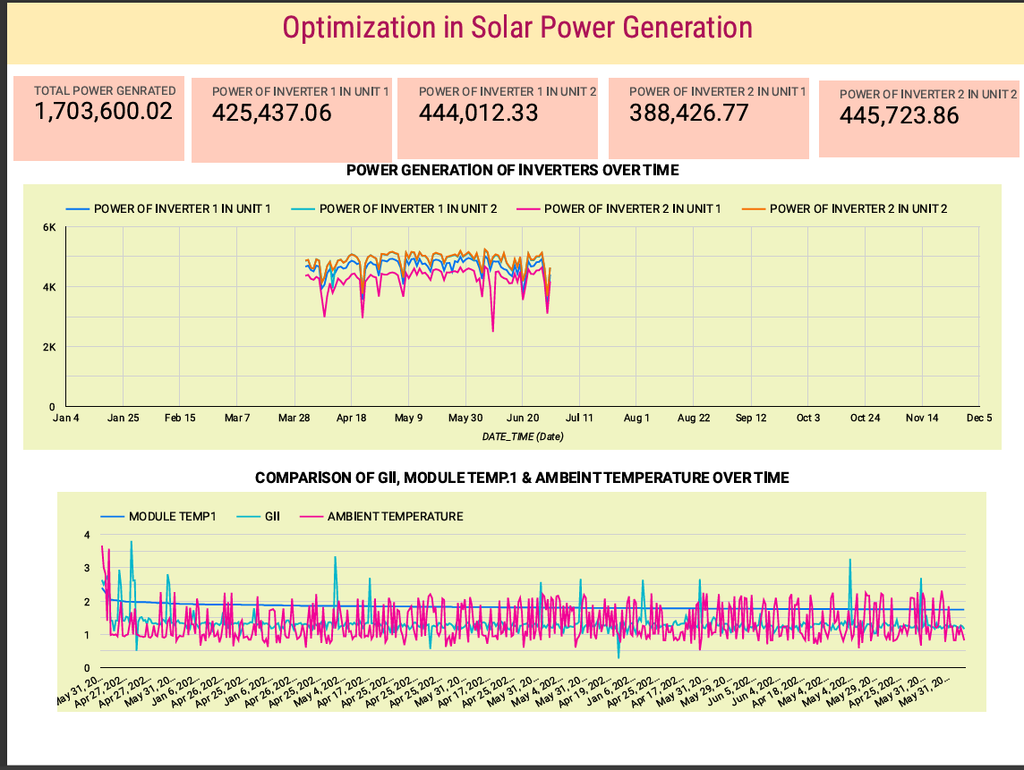
Data Visualization
Notes:
Add graphical

Slide 15
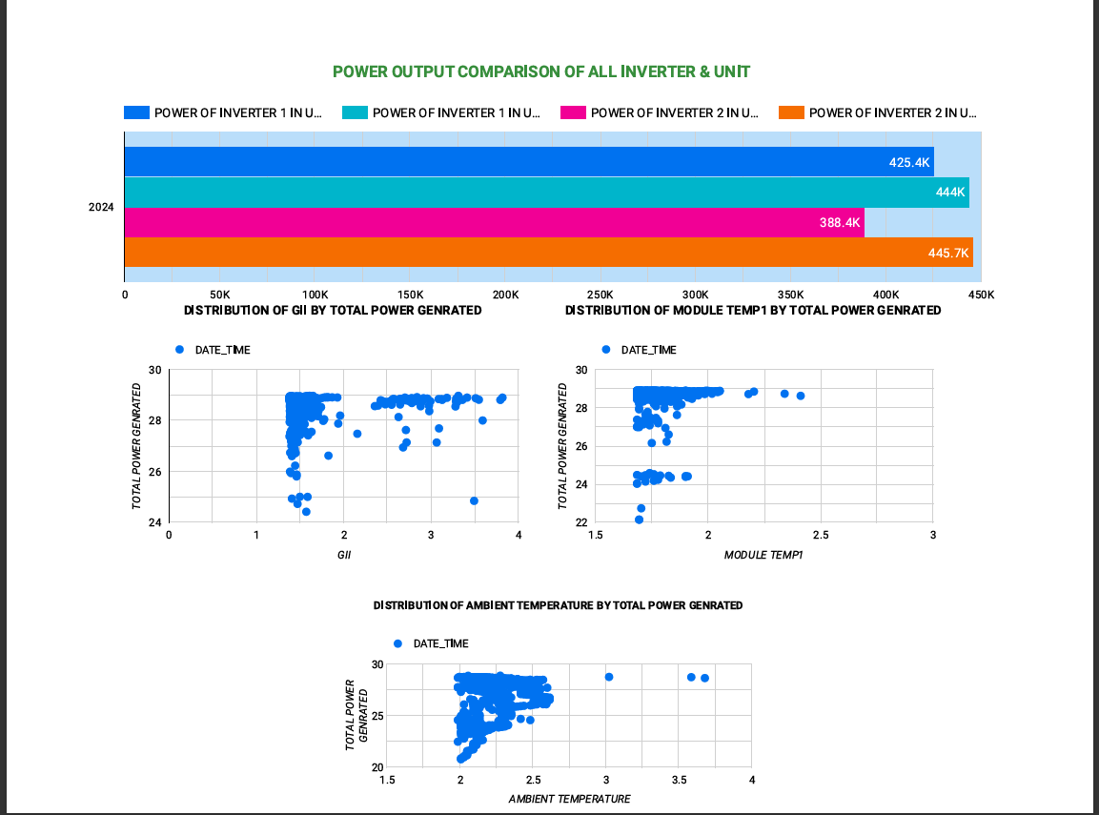
Data Visualization
Notes:
Add graphical

Slide 16


